Slide 1
Object Oriented Programming DITP 3113
Lecturer : PUAN MASLITA BT ABD AZIZ
Group Member:
No. | Name | Matric No. | Section/ Group
1. | CHAN MANG YONG | D032110073 | S1G2
2. | MUSTAFA BIN JAMIL | D032110257 | S1G1
3. | OOI KHAR NEE | D032110421 | S1G1
4. | MARIA MAGDELENA MASAN | D032110204 | S1G1

Slide 2
Object Oriented Programming DITP 3113
Project Title: GROCERY
INVENTORY SYSTEM
INTRODUCTION
Lecturer : PUAN MASLITA BT ABD AZIZ
Group Member:
No. | Name | Matric No. | Section/ Group
1. | CHAN MANG YONG | D032110073 | S1G2
2. | MUSTAFA BIN JAMIL | D032110257 | S1G1
3. | OOI KHAR NEE | D032110421 | S1G1
4. | MARIA MAGDELENA MASAN | D032110204 | S1G1

Slide 3
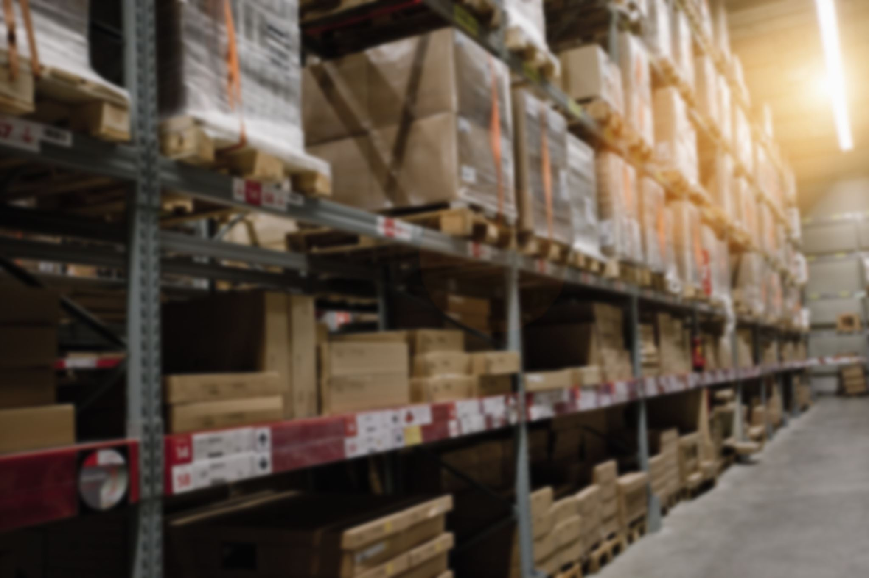
Project Title: GROCERY
INVENTORY SYSTEM
INTRODUCTION
Object Oriented Programming DITP 3113
A grocery inventory system is a systematic approach to sourcing, storing,
editing, searching, and viewing two types of items in groceries which are
food and drink. This system is easier to use where users can add items
to the grocery by simply indicating the item name, arrival date, expiration
date, item price, and quantity of an item. But for the item id, it will
generate automatically. Other than that, this system can also search for an item by choosing which item to search either food or drink. Then, the user can search for the item by entering the id of the item or the name of the item.
Group Member:
Lecturer : PUAN MASLITA BT ABD AZIZ

Slide 4
Project Title: GROCERY
INVENTORY SYSTEM
INTRODUCTION
A grocery inventory system is a systematic approach to sourcing, storing,
editing, searching, and viewing two types of items in groceries which are
food and drink. This system is easier to use where users can add items
to the grocery by simply indicating the item name, arrival date, expiration
date, item price, and quantity of an item. But for the item id, it will
generate automatically. Other than that, this system can also search for an item by choosing which item to search either food or drink. Then, the user can search for the item by entering the id of the item or the name of the item.
Next, this system can restock any item if the item for example out of stock or has expired. In order to do that, a user has to enter the id or name of the item to restock. However, despite being able to restock an item, the user can also edit any item just in case the item details are entered incorrectly when adding the item to the grocery in the first place. Last but not least, a user can display a list of all items to check the details such as expiration date. In addition, users can sort food and drink items by any condition but can’t sort by the type of item since the item already separate into two tables of food and drink items.

Slide 5
UML Diagram:
Project Title: GROCERY
INVENTORY SYSTEM
INTRODUCTION
Next, this system can restock any item if the item for example out of stock or has expired. In order to do that, a user has to enter the id or name of the item to restock. However, despite being able to restock an item, the user can also edit any item just in case the item details are entered incorrectly when adding the item to the grocery in the first place. Last but not least, a user can display a list of all items to check the details such as expiration date. In addition, users can sort food and drink items by any condition but can’t sort by the type of item since the item already separate into two tables of food and drink items.
A grocery inventory system is a systematic approach to sourcing, storing,
editing, searching, and viewing two types of items in groceries which are
food and drink. This system is easier to use where users can add items
to the grocery by simply indicating the item name, arrival date, expiration
date, item price, and quantity of an item. But for the item id, it will
generate automatically. Other than that, this system can also search for an item by choosing which item to search either food or drink. Then, the user can search for the item by entering the id of the item or the name of the item.
Gambo Nye

Slide 6
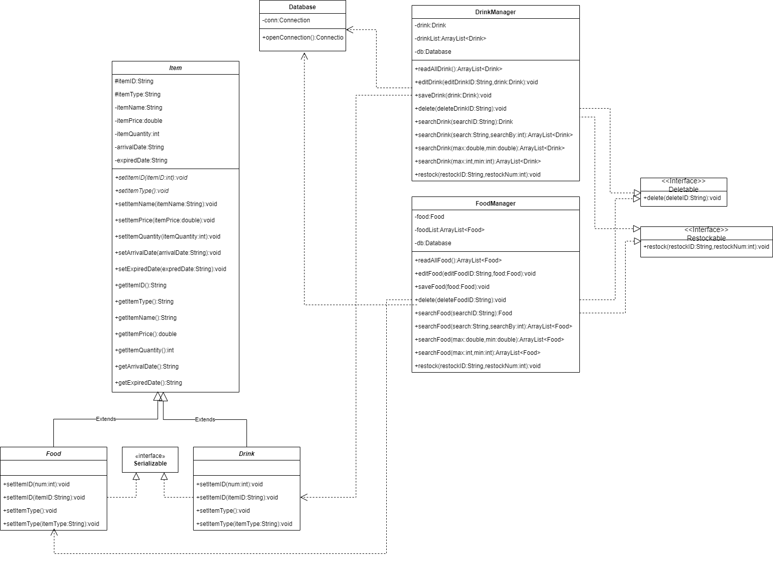
UML Diagram:
Project Title: GROCERY
INVENTORY SYSTEM
INTRODUCTION
Next, this system can restock any item if the item for example out of stock or has expired. In order to do that, a user has to enter the id or name of the item to restock. However, despite being able to restock an item, the user can also edit any item just in case the item details are entered incorrectly when adding the item to the grocery in the first place. Last but not least, a user can display a list of all items to check the details such as expiration date. In addition, users can sort food and drink items by any condition but can’t sort by the type of item since the item already separate into two tables of food and drink items.

Slide 7
UML Diagram:
THANK YOU!
Gambo Nye

